Slide 1
CSE 220
Jannatun Noor
Jannatun.noor@bracu.ac.bd
Lecture Made by: Aminul Huq

Slide 2
Key Indexed Searching
Let's say we have an array A of non-negative (why?) integers that we want to search for very quickly.
If we think of implementing a set or a map (also called a dictionary), we can do the following: Use the values in A (the keys) as indices into another array B, which must have a capacity of one greater than the largest key in A.

Slide 3
Key Indexed Searching
Let's say we're given an array A = [5 1 7 2 8 4], and we want to quickly search for some key in A.
We first create another array B which has a capacity of one larger than largest element in A, which is 8 + 1 = 9.
Then we populate B with the elements in A as indices into B

Slide 4
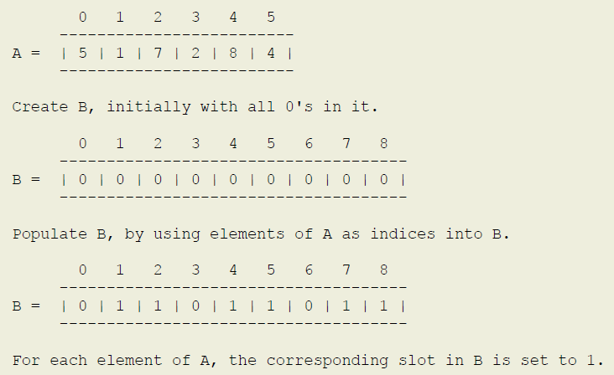

Slide 5
Key Indexed Searching
Searching for any key can be done by simply indexing into B using the key as an index — if the slot is used (that is, the value is 1), then the key exists in A; otherwise, it does not.
Searching for 8 in A, we see that B[8] == 1, so 8 exists in A; searching for 6 in A, we see that B[6] == 0, so 6 does not exist in A; and so on.

Slide 6
Key Indexed Sorting
We can also use this technique to sort in linear time.
Compare that to the best we've seen so far n^2 bubble/selection/insertion sorts.
An added restriction on the input is that the keys must be distinct in addition to being non-negative.
Let's say we have to sort the a A = [5 1 7 2 8 4] that we used in our search example. The setup phase is exactly the same — we create B and then populate it using the elements of A as indices into B.

Slide 7
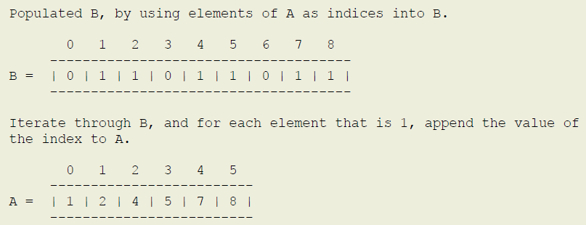
Now we can walk through B and output the elements that are set to 1, and we get the sorted output.

